Slide 1
Civil War Timeline (1861-1865)
* - Battles researched
By:
Neel Balusa
Rohan Dharmadhikari
Vinay Deshmukh

Slide 2
Battles in 1861
Fort Sumter*
Bull run/First Manassas*
Fort Washington
Wilson Creek*
Lexington*

Slide 3
Bull Run/First Manassas
-Rohan
July 21st 1861, Union General Irvin McDowell marched down into northern Virginia and met confederate forces under Joseph E. Johnston and P.G.T Beauregard near a small town, Manassas.
There were 32,230 Confederate soldiers against 23,450 Union soldiers. 1:1 odds
Casualties:
Union – 2896
Confederate - 1892

Slide 4
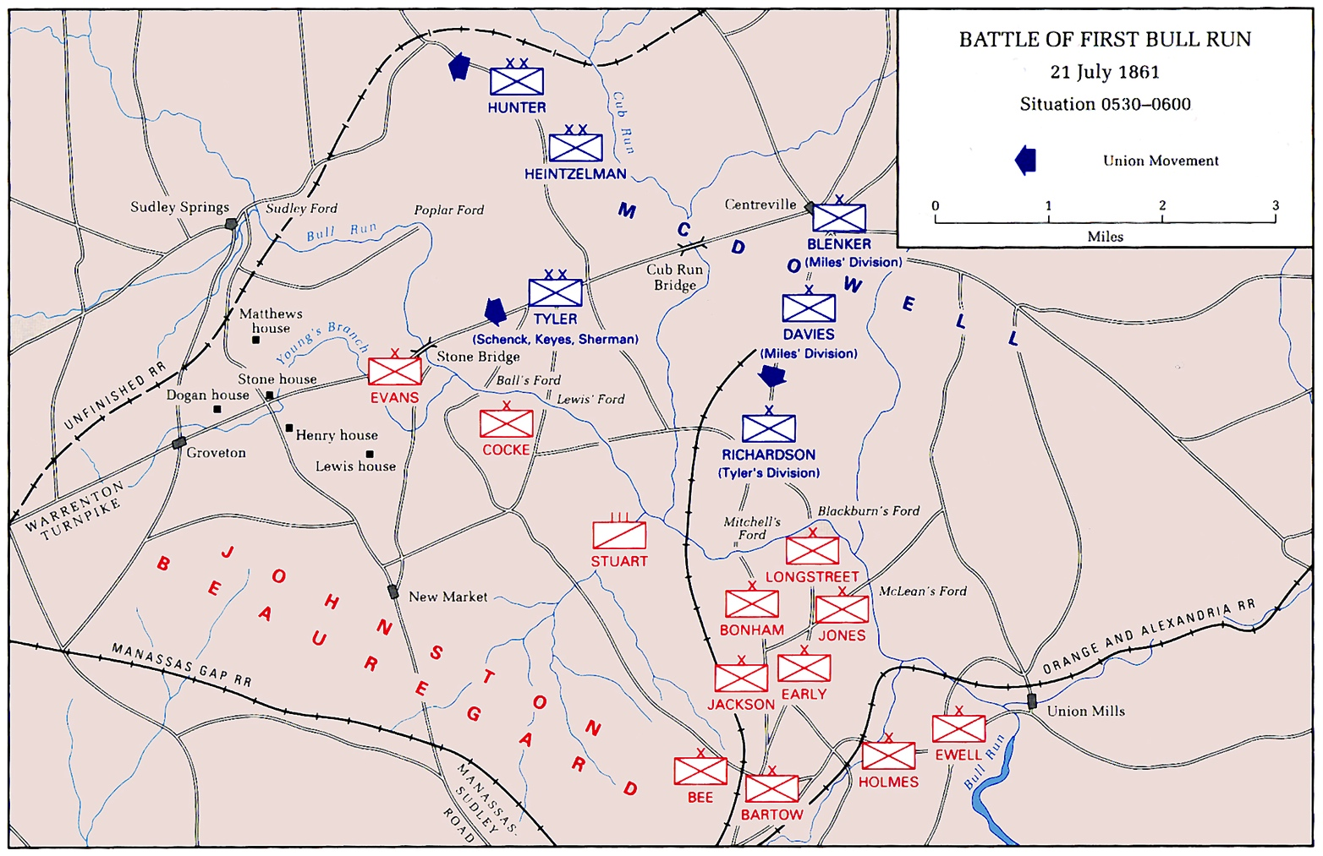

Slide 5
Lexington
-Vinay
September 12th – Confederate and Missouri state guard advance to Lexington after the Union defeat at Wilson Creek.
Confederates: General Claiborne Fox Jackson and Sterling Price. Union General: James A. Mulligan and Robert T. Van Horn
Confederates 20,000 and Union 3,500 battle soldiers led to casualties. 6-1 odds
100 confederate
1,774 union

Slide 6
Battles 1862
Battle of Roanoke Island
Fort Donelson*
Battle of Pea Ridge
Shiloh*
Battle of seven Pines
Second Bull Run*
Antietam*
Fredericksburg*

Slide 7
Fort Donelson
-Neel
February 11-16th, 1862 Andrew Hull Foote and Ulysses S. Grant for the Union and for the Confederates Gideon J. Pillow, John Buchman Floyd, and Simon Buckner.
16,171 Confederates battling against 24,531 Union. 1-1.5 odds
Casualties for
Confederates – 13,846
Union – 2,691

Slide 8
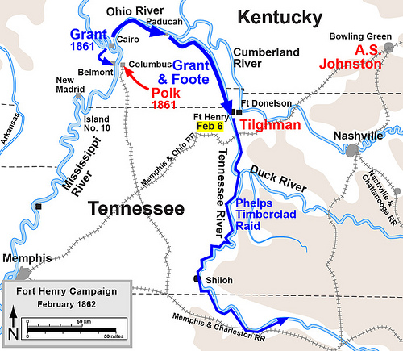

Slide 9
Shiloh
-Rohan
April 6th-7th total forces engaged 110,053, The confederates Generals were Albert Sidney Johnston and P.G.T Beauregard. The Union held Don Carlos Buell and Ulysses S. Grant
Confederate Forces were 44,968 and Union Forces were 65,085
Casualties:
Confederate – 10,669
Union – 13,047

Slide 10
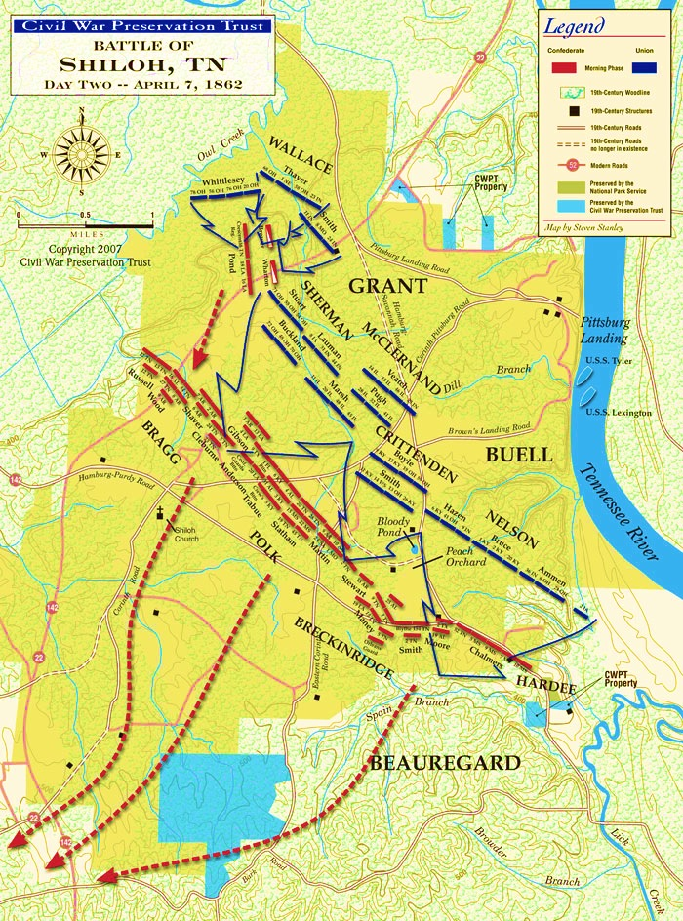

Slide 11
Second Bull Run
-Rohan
August 28th Confederate General Stonewall Jackson attacked a lone Union division to cut of Union General Pope’s supply line.
Confederate Forces: 55,000;
Union Forces: 70,000
Confederate Casualties: 1,305
Union: Casualties: 1,716

Slide 12
Antietam
-Vinay
September 16th-18^{th-} Forces: 131,000
Confederate: 45,000
Union: 87,000
Generals:
Confederate: Robert E. Lee
Union: George B. McClellan
Casualties
Confederate: 10,316
Union: 12,401

Slide 13
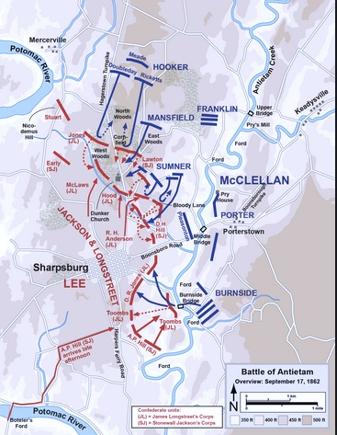

Slide 14
Fredericksburg
-Neel
December 11-15 Total Forces: 172,504
Confederates: 72,947
Union 100,007
Generals
Confederates: Robert E. Lee
Union: Ambrose E. Burnside
Casualties
Confederates: 4,576
Union: 13,353

Slide 15
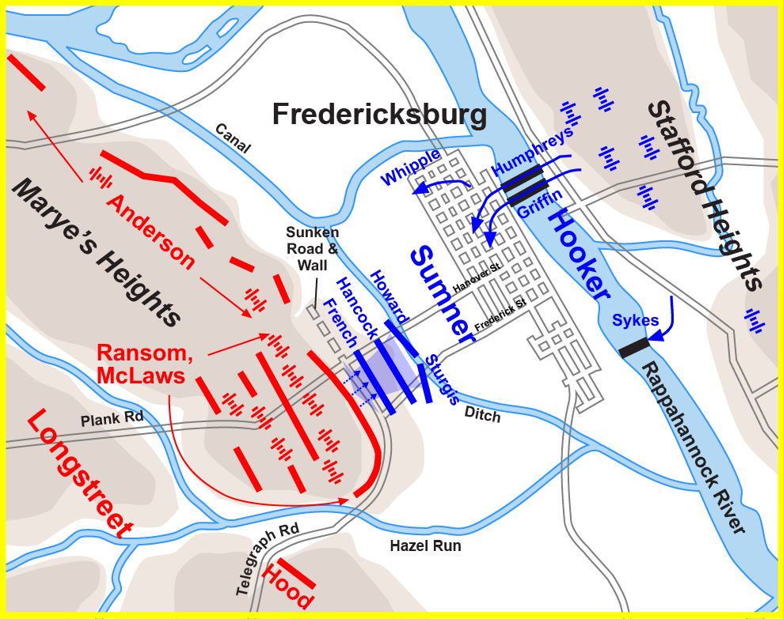

Slide 16
Battles of 1863
Emancipation Proclamation*
Chancellorsville*
Second Winchester
Gettysburg*
Vicksburg Captured July 4^{th*}
Draft riots
Chattanooga
Chickamauga*
Knoxville

Slide 17
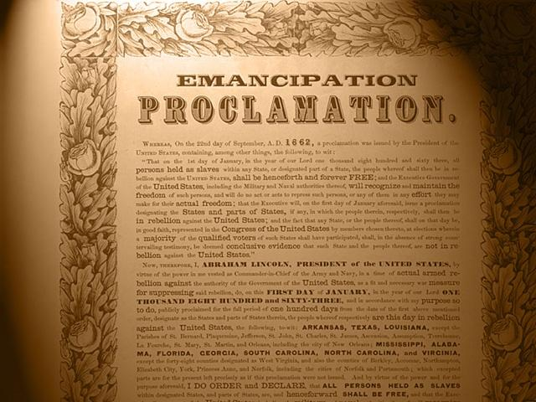
Emancipation Proclamation
-Vinay

Slide 18
Chancellorsville
-Rohan
April 30th to May 6th
Commanding Officers
Union General Joseph Hooker
Confederate General Robert E. Lee and Stonewall Jackson
In an astonishing turn of events, friendly fire from the Confederate Forces, Stonewall Jackson is shot and dies of Pneumonia 6 days later.
Lee’s greatest bittersweet victory.
Rebels Engaged: 57,352
Yankees Engaged: 97,382
Rebel Casualties: 1,724
Yankee Casualties: 1,694

Slide 19
Gettysburg
-Neel
July 1-3 Total forces engaged: 165,620
Confederates: 71,699
Union: 93,921
Generals
Confederates: Robert E. Lee
Union: George G. Meade
Casualties: 51,112
Confederates: 28,063
Union: 23,049

Slide 20
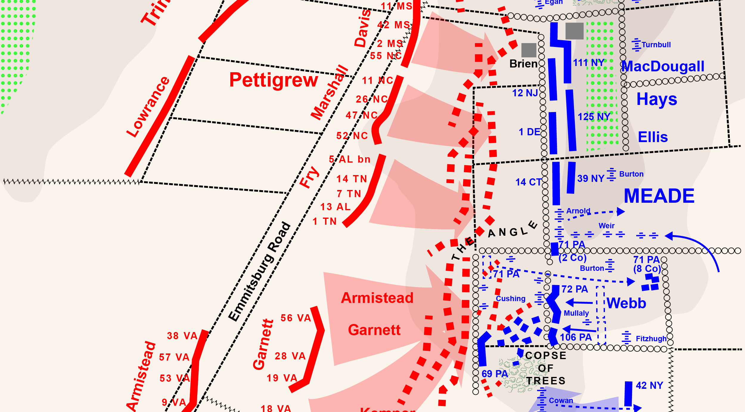
Pickets Charge

Slide 21
Vicksburg Captured
-Neel
May 18 – July 4th Total Forces: 110,000
Confederates: 33,000
Union: 77,000
Generals
Confederates: John C. Pemberton
Union: Ulysses S. Grant
Casualties
Confederates: 32,492
Union: 4,910

Slide 22
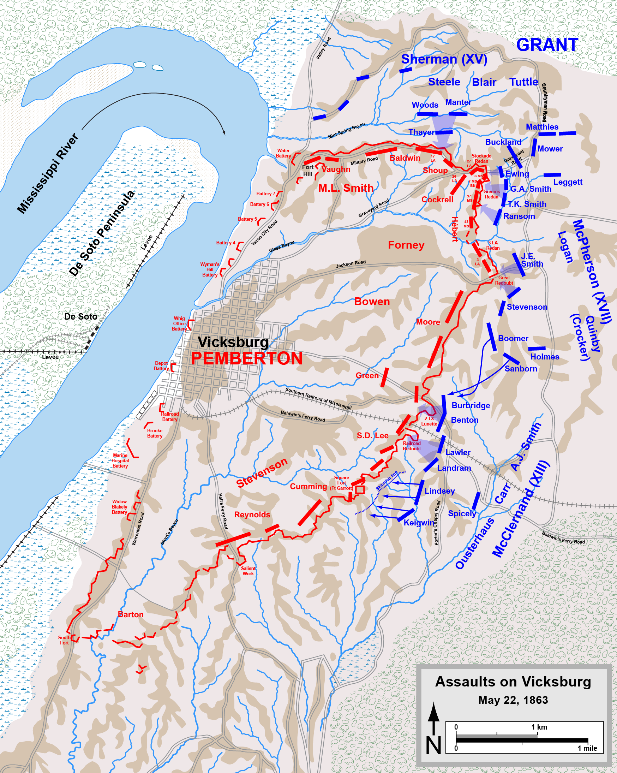

Slide 23
Chickamauga
-Vinay
September 12th-20th: 125,000 total soldiers
Confederate: 65,000
Union: 60,000
Generals:
Confederate: Braxton Bragg
Union: William S. Rosecrams
Casualties
Union: 60,000
Confederates: 65,000

Slide 24



Battles of 1864
Meridian
Charleston: submarine attack*
Grant appointed general of Potomac
Pleasant hill
Fort pillow*
Wilderness
Spotsylvania
Cold harbor
Brice's crossroads
Mobile bay
Atlanta falls*
Cedar creek
Nashville*

Slide 25
Fort pillow
-Rohan
On April 12th Confederate General Nathan Bedford Forrest stormed into Fort Pillow in where a garrison of 300 African Americans were massacred. Both Union Commanders Lionel F. Booth and William F. Bradford were killed
Rebels involved: 2,500
Union Garrison: 600
Rebels killed: 100
Union soldiers killed: 600

Slide 26
Nashville
-Rohan
On December 16th Union General George Thomas approached Darrison County, Nashville, Tennessee. Confederate General John Bell Hood takes him head on although he is outnumbered.
Confederates Engaged: 30,000
Union Soldiers Engaged: 55,000
Confederate Casualties: 6,000
Union Casualties: 3,061

Slide 27
Battles of 1865
Assault of fort fisher
Columbia south Carolina
Fall of Petersburg*
Battle of five forks
Fall of Richmond*
Lincoln assassinated*
Jefferson Davis captured
Palmetto ranch*

Slide 28
Fall of Petersburg
-Rohan
On April 2nd, 1864 Union General Ulysses S. Grant and his corps marched up to Petersburg, Virginia

Slide 29
Richmond
-Vinay

Slide 30
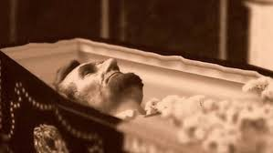
Lincoln Assassinated
-Neel
April 15th 1865
John Wilkes Booth shot Lincoln In the head
Lincoln died at a theater event
The whole Union was shaken
Union soldiers tracked Booth down a week later

Slide 31
Palmetto Ranch
-Vinay
The Battle of Palmetto Ranch was a relatively un-important battle though it was the last battle of the civil war.
Casualties
Confederates: 6
Union: 118
Why the North won: The North clearly had more men to fight for them and there were more people who wanted to put an end to slavery including the slaves themselves. The North managed to enroll many people for the war.

Slide 32
Citations
www.nps.gov/gett/learn/historyculture/civil-war-timeline.htm
www.americancivilwar.com
www.nps.gov/abpp/battles/mo004.htm
www.civilwar.org/battlefields/wilson-s-creek.html
www.civilwaronthewesternborder.org/content/battle-Lexington
www.civilwar.org/battlefields/fort-donelson.html
www.civilwar.org/battlefields/shiloh.html
www.dailykos.com
www.thomaslegion.net
http://www.civilwar.org/battlefields/fredericksburg.html
http://www.civilwar.org/antietam.html

Slide 33
Citations
www.en.wikipedia.org
http://www.archives.gov/exhibits/featured_documents/emancipation_proclamation/
www.wach.com
http://www.historyrocket.com/American-History/civil-war/Why-Did-The-North-Win-The-Civil-War.html
http://commons.wikimedia.org/wiki/File:Second_Bull_Run_Aug29_1700.png
http://en.wikipedia.org/wiki/First_Battle_of_Bull_Run#/media/
http://thomaslegion.net/battleofchancellorsvillebattlefieldpositions.html
http://www.custermen.com/DixieBoys/FtPillow.htm
http://www.bonps.org/wpr/wp-content/uploads/2011/03/Kay-pix-Mar11-054-copy.jpg
http://commons.wikimedia.org/wiki/File:Petersburg_July30.png

Slide 34
Citations
http://www.civilwar.org/battlefields/nashville.html?tab=facts
http://www.civilwar.org/battlefields/bullrun.html?tab=facts
http://www.civilwar.org/battlefields/petersburg-breakthrough.html
http://www.civilwar.org/battlefields/second-manassas.html
http://www.civilwar.org/battlefields/chancellorsville.html

